Slide 1
mNGS study
Update report

Slide 2
Workflow
Raw Files
virstrain
fastp
-update metadata
kraken2
kraken-biom
-extract taxonomy table
recentrifuge
-extract filtered reads
phyloseq
-normalization, diversity analysis, taxonomic visualization

Slide 3

Sample size
From original metadata, n = 143 (based on rt-pcr - positive = 70, negative = 73)
Samples with raw sequences, n = 110
From samples with raw sequences,
Positive according to virstrain - n = 39 (not aligned with rt-pcr results)
Used for this initial analysis, n = 75
Positive = 39 (all positive in virstrain)
Negative = 36
removed samples with low reads
Notes: - no sample size computations performed (in the process of understanding how this works )

Slide 4
Metadata content
LAB ID | AGE | SEX | DRU | Symptoms | DATE OF ONSET OF ILLNESS | DATE OF COLLECTION | TIME OF COLLECTION | TEST DONE | DATE TESTED | RESULT
COV20-99705 | 80 | M | ADVENTIST MEDICAL CENTER MANILA | MISSING | 15/05/2020 | 06/09/2020 | 10:45:00 | SARS-CoV-2 RT-PCR | 06/10/2020 | Viral RNA detected
COV20-366040 | 59 | M | MALIBAY HEALTH CENTER | MISSING | - | 12/01/2020 | 09:30:00 | SARS-CoV-2 RT-PCR | 12/03/2020 | Viral RNA not detected

Slide 5
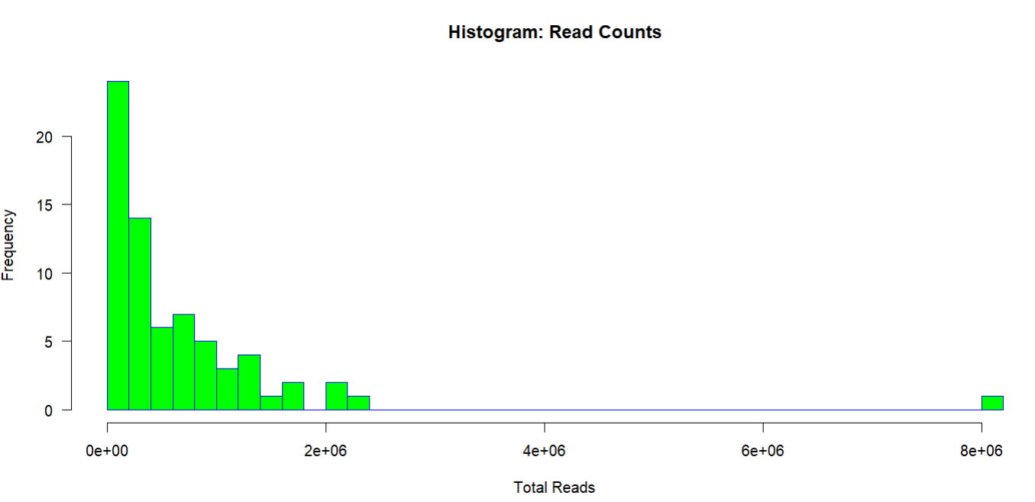
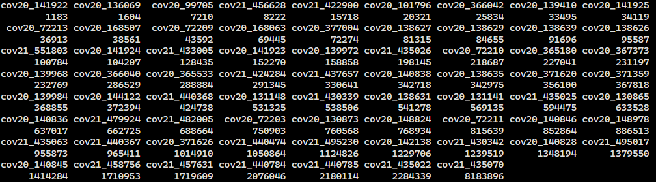
Read counts per sample

Slide 6
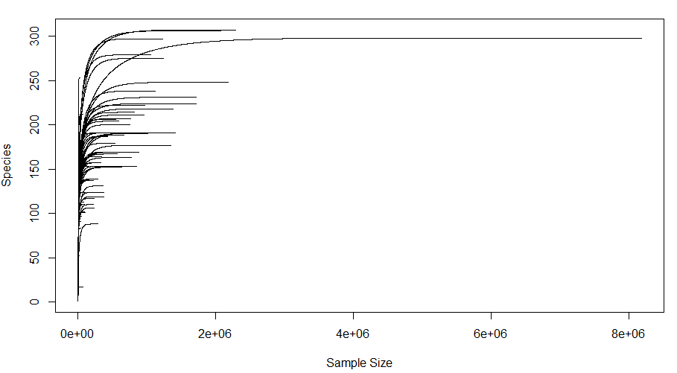
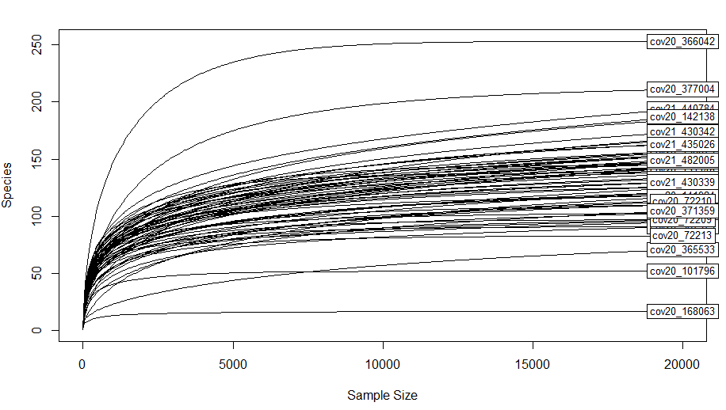

Slide 7
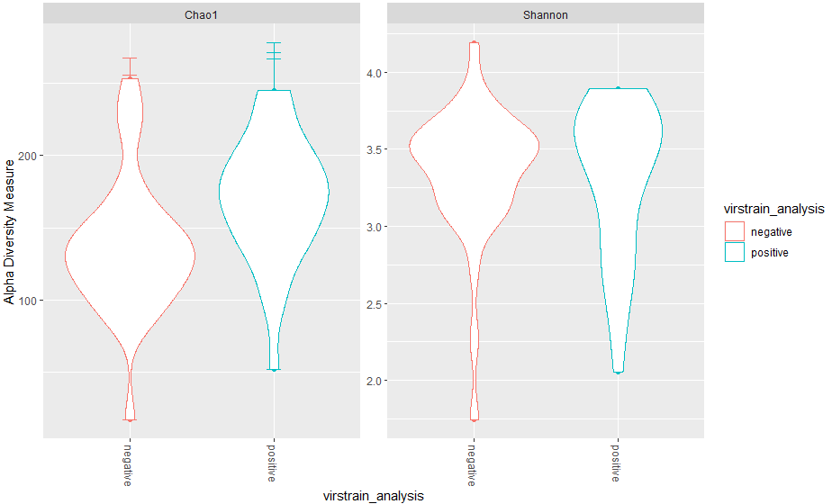
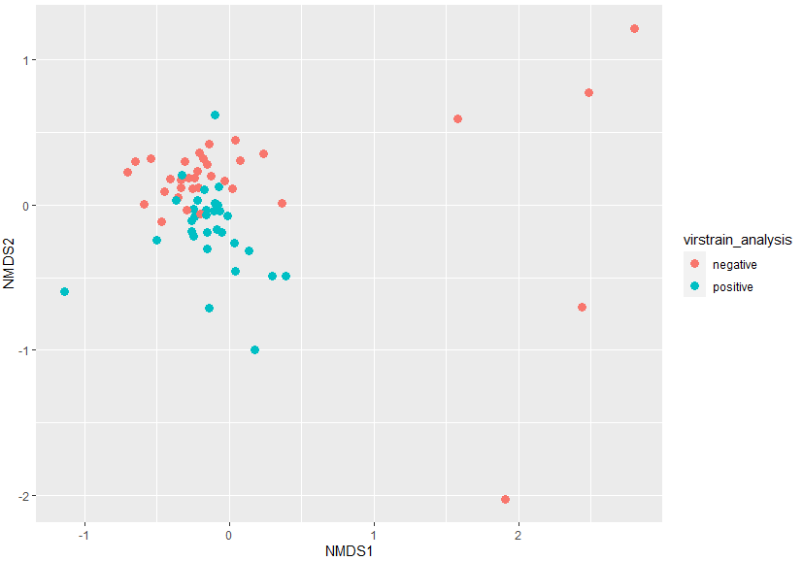

Slide 8
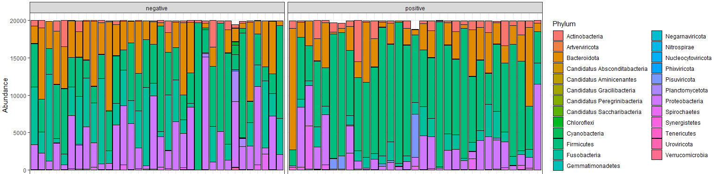
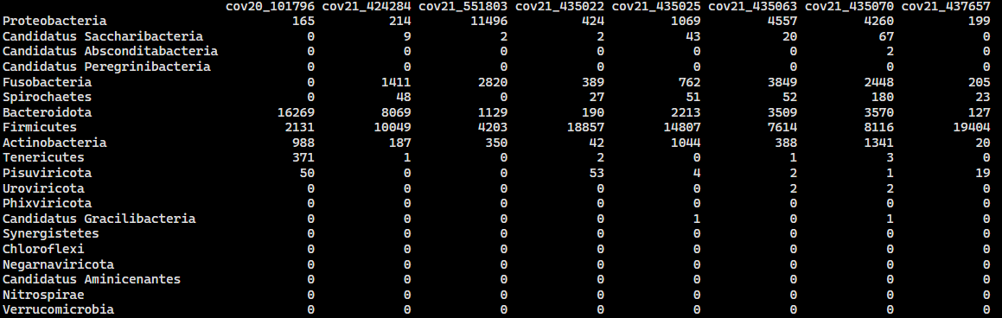

Slide 9
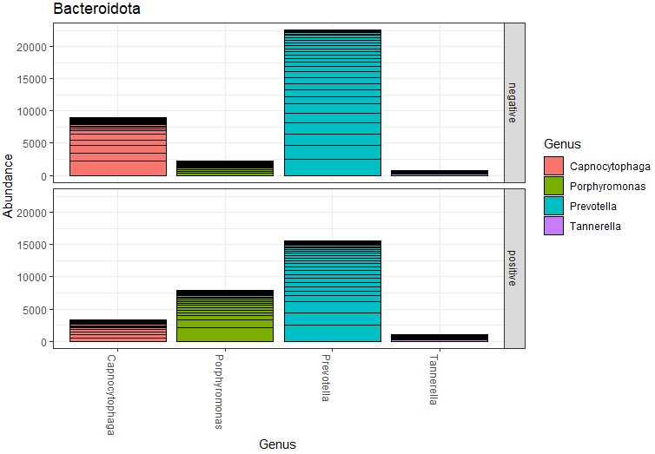
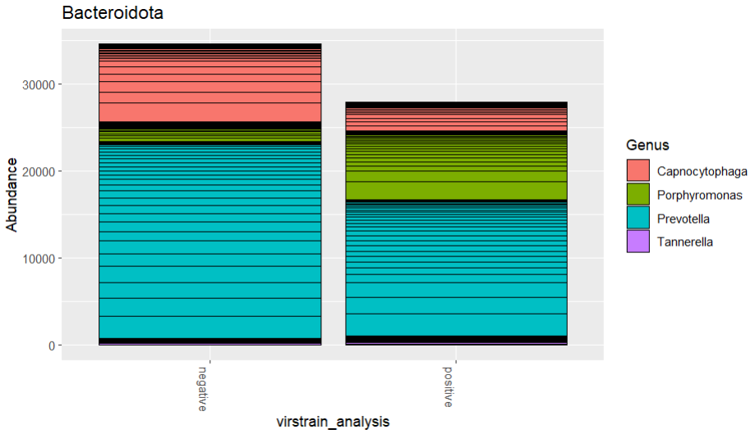

Slide 10
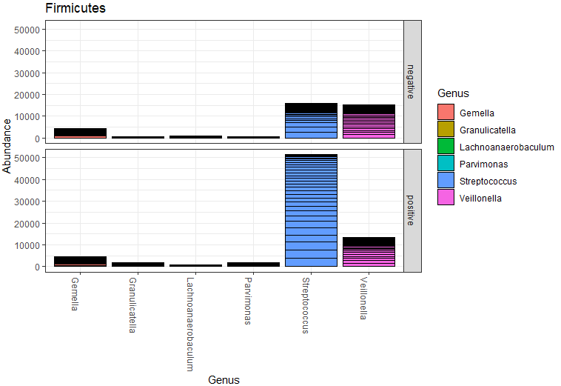
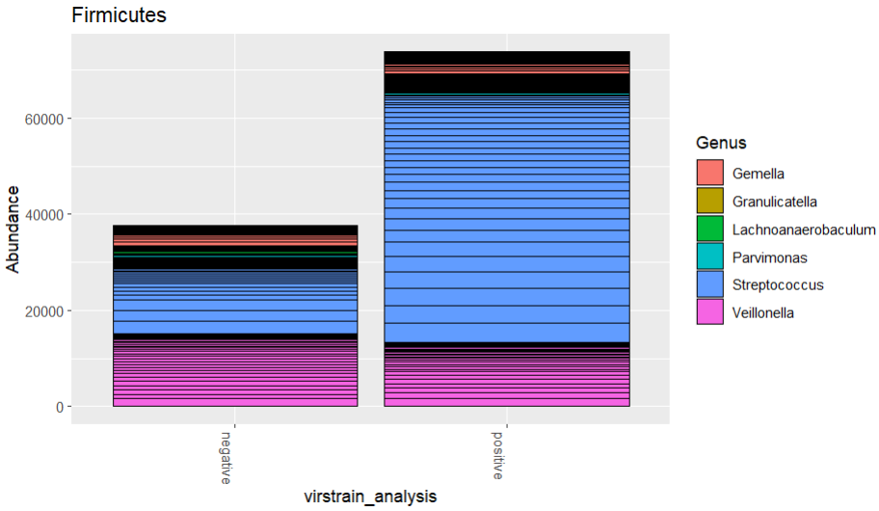

Slide 11
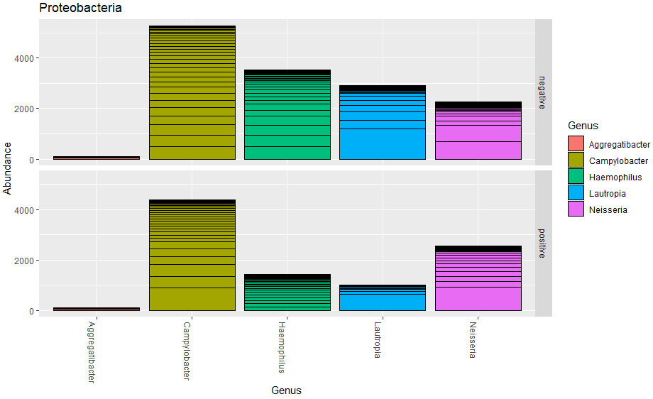
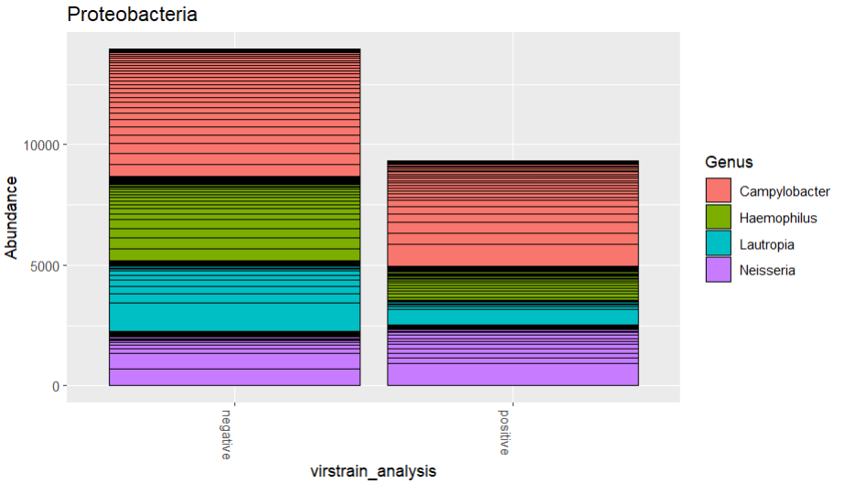

Slide 12
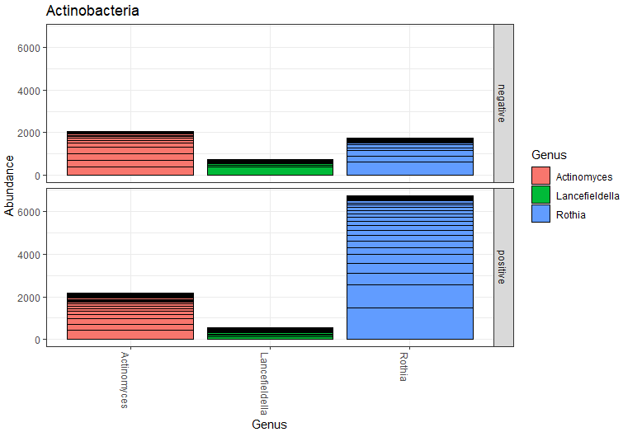
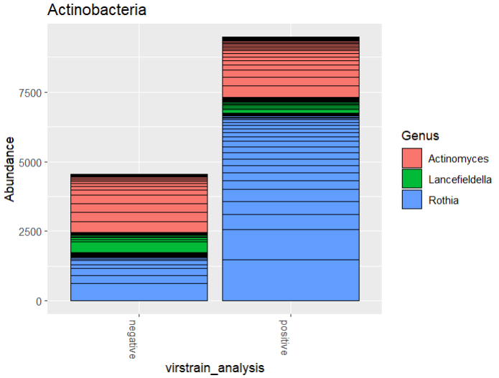

Slide 13
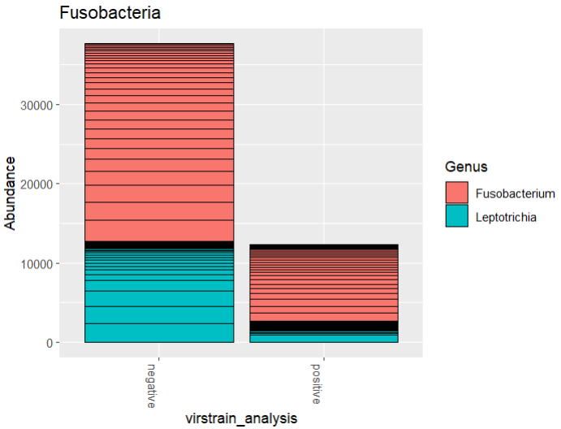
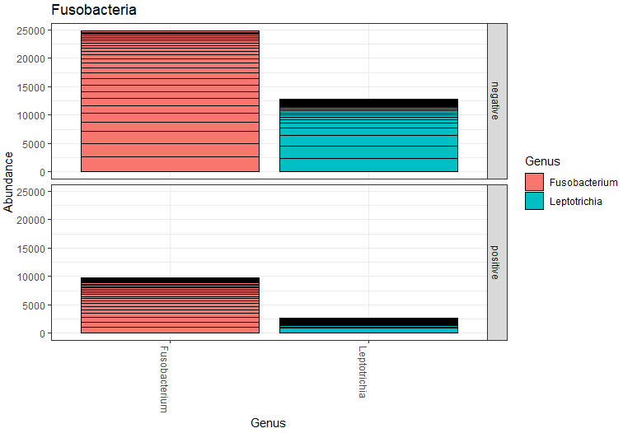

Slide 14
Questions
Right direction?
Statistics?
Consider biases in gene expression levels/copy number?
Improvement?
Others:
Human reads processing (differential gene expression)
Other Taxa

Slide 15
Salamat po

